Slide 1
Seychelles
By:Michal Trgala
7.A

Slide 2
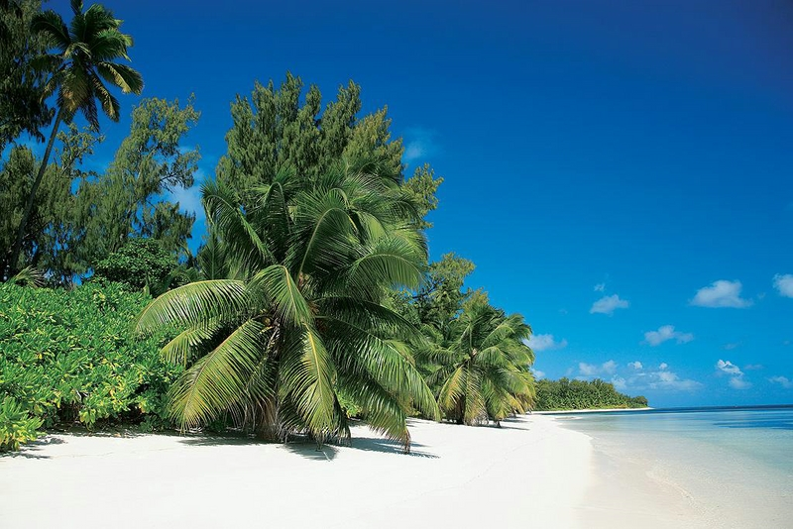
Content
Capital city
Climate
Summary
Pictures
Sources

Slide 3
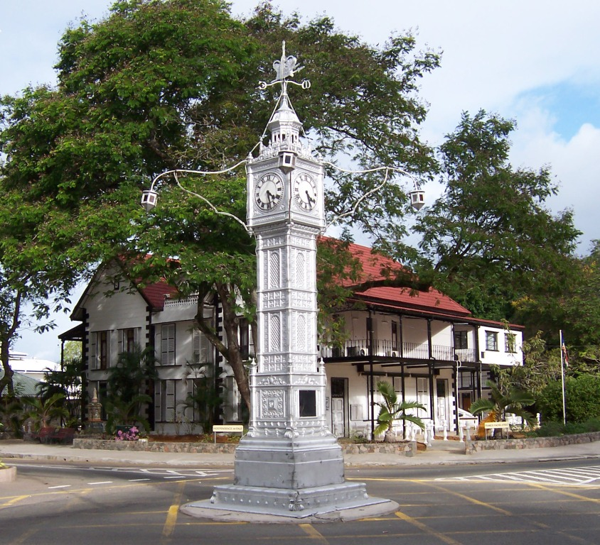
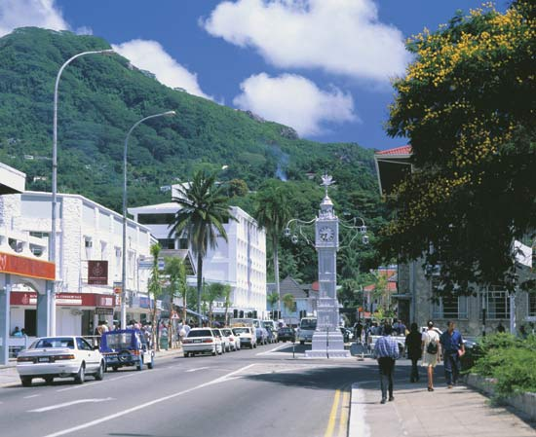
Capital city-Victoria
Victoria is the capital city of the Seychelles.
The symbol of Victoria is a clock tower, miniature London's Big Ben.

Slide 4
Climate
Seychelles have a typical oceanic climate.
Average temperatures are high throughout the year.
The average temperature ranges from 29 to 30 degrees Celsius.
Seychelles is sufficient rainfall, which bodes well for tropical vegetation.

Slide 5
Summary
Area-455 sq km.
Seychelles consists of 114 islands-
Of which 41 inner islands
73 outer islands
Location-western Indian Ocean
Capital city-Victoria

Slide 6
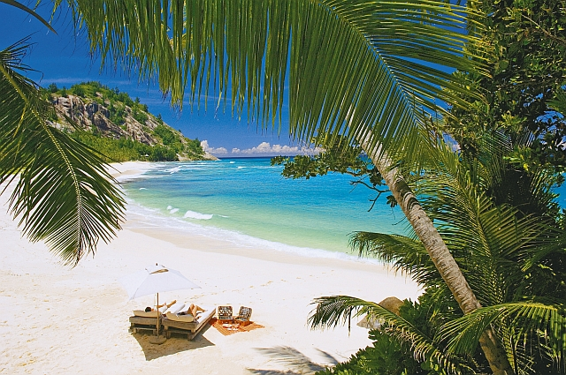
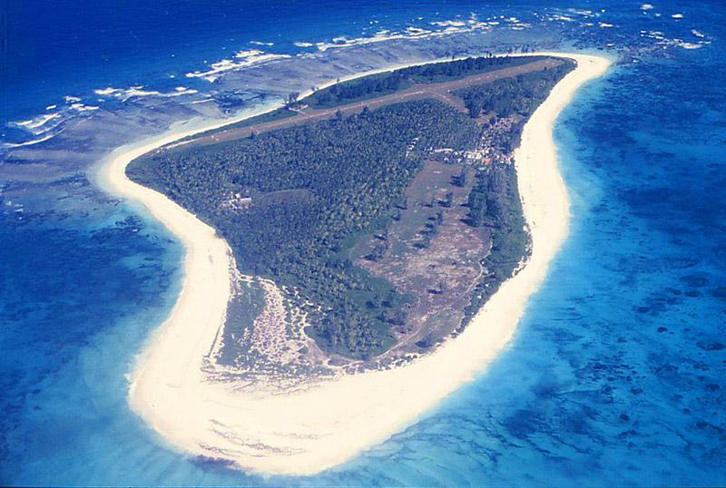
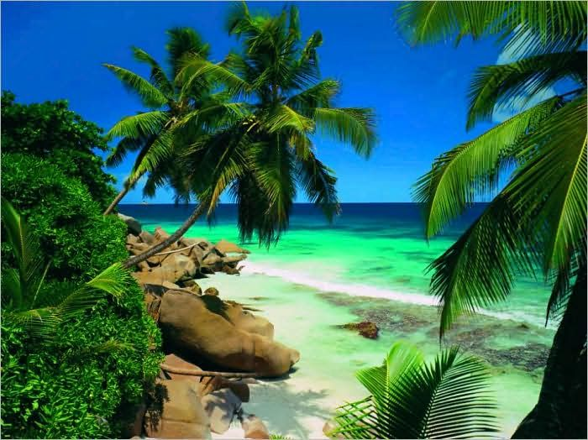
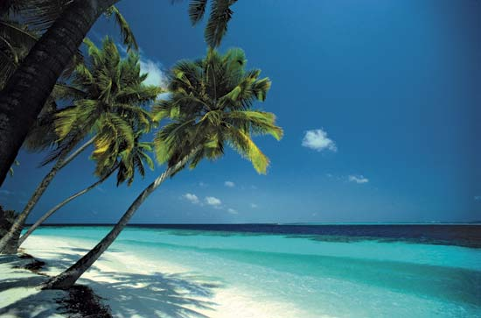
Pictures

Slide 7
Thank you for your attention
Sources: Wikipedia
Google

